Slide 1

Hypothesis testing and inferential statistics

Slide 2
Hypothesis testing

Slide 3
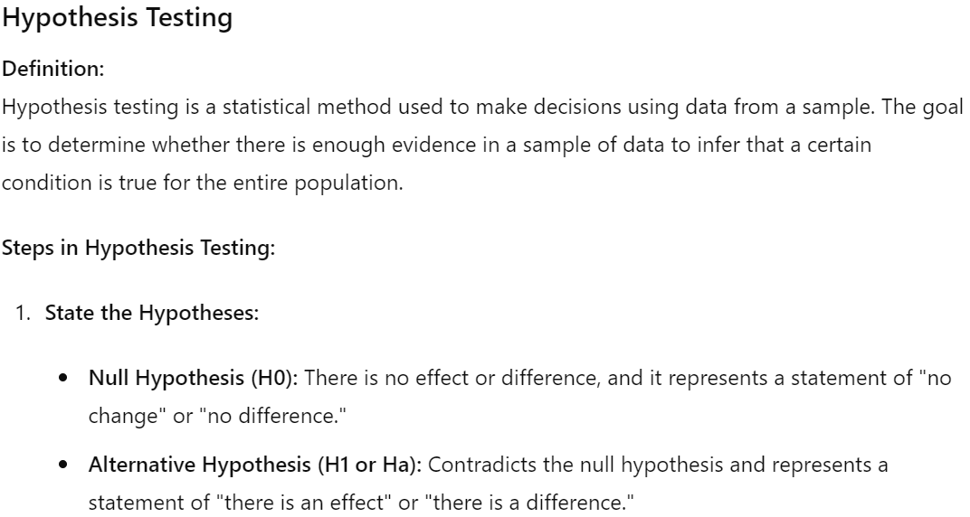

Slide 4
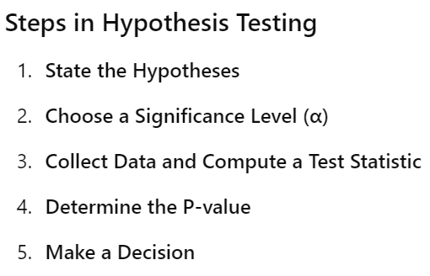

Slide 5
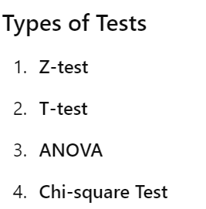


Slide 6



Slide 7
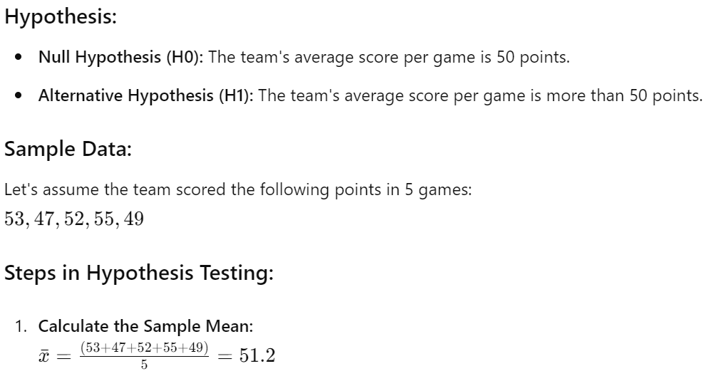

Slide 8
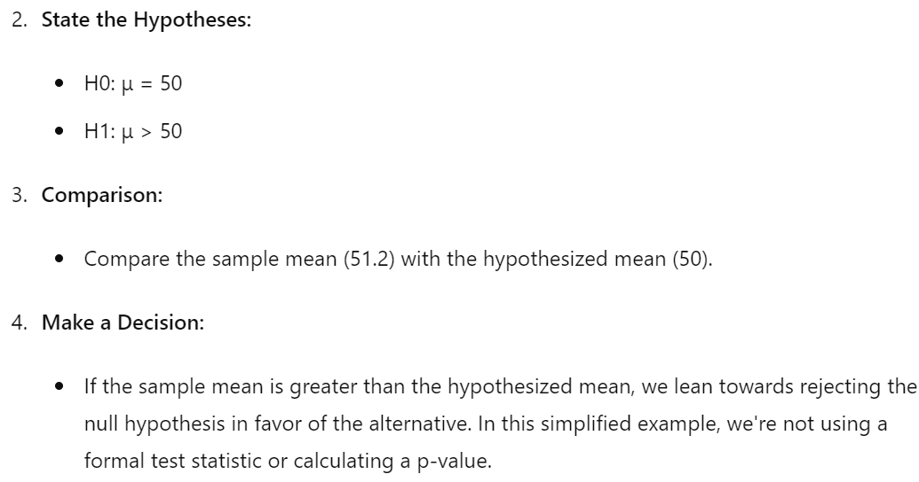

Slide 9



Slide 10
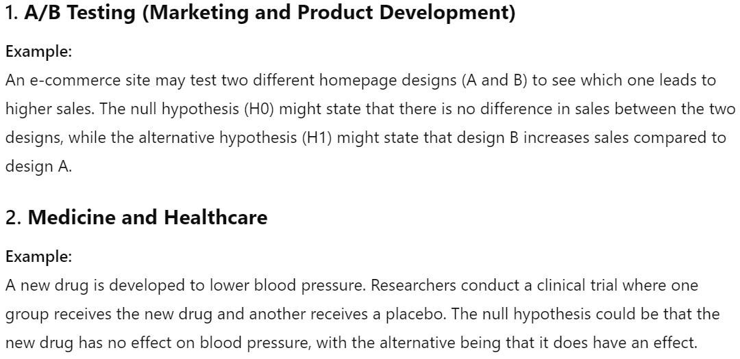

Slide 11
Inferential Statistics

Slide 12

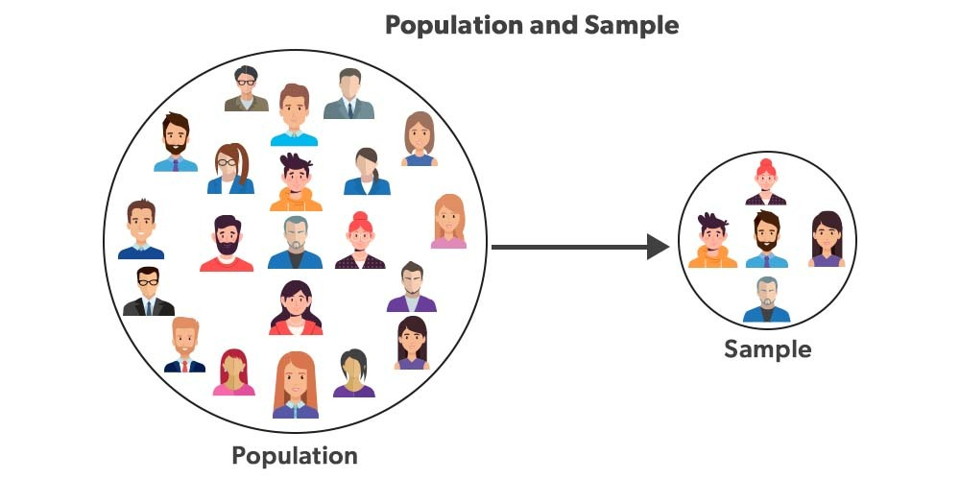

Slide 13


Slide 14



Slide 15


Slide 16
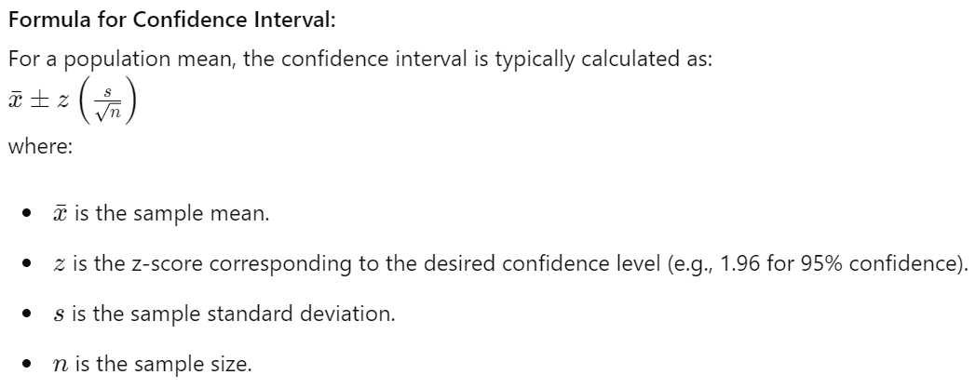

Slide 17
Thank You

